Slide 1

Android - Kotlin
AllPhi Fleet Management Application

Slide 2
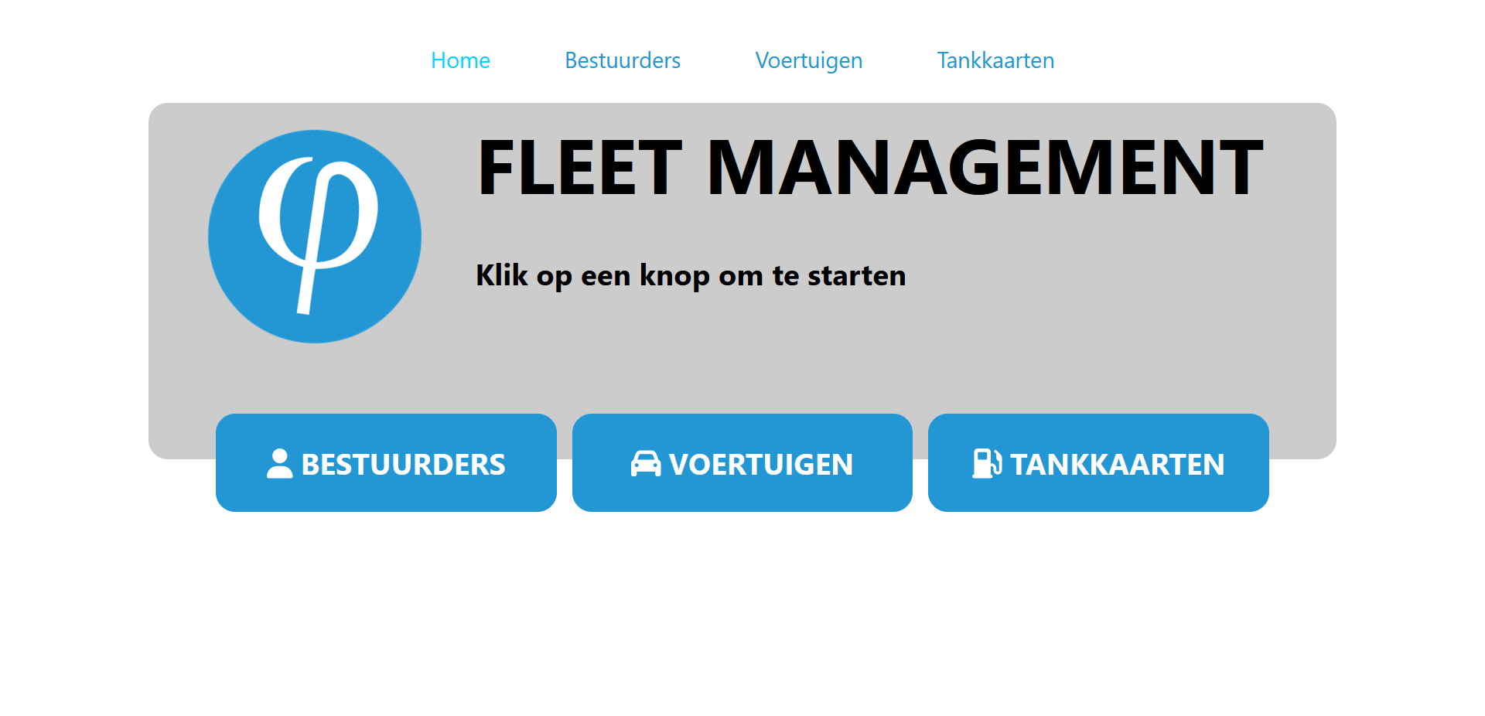

Slide 3
http://affiche.me:3000/
https://affiche.me:7144/api/drivers

Slide 4


Slide 5
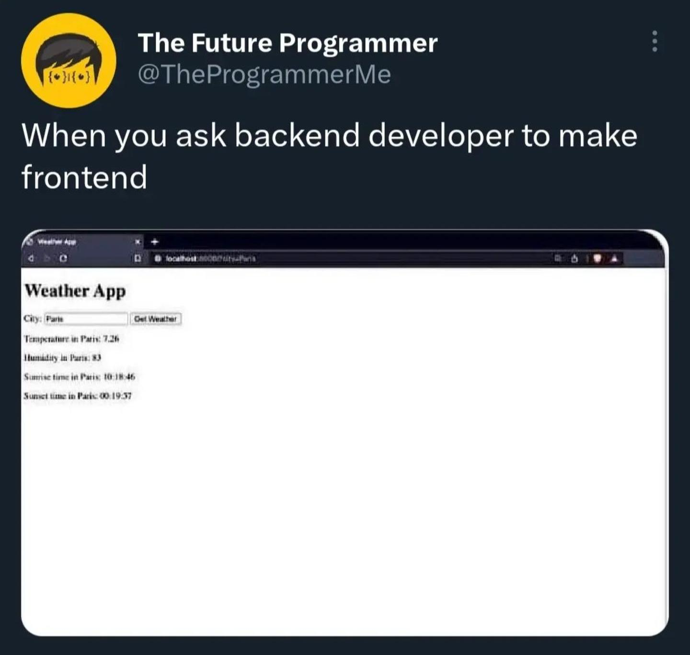

Slide 6


Slide 7


Slide 8
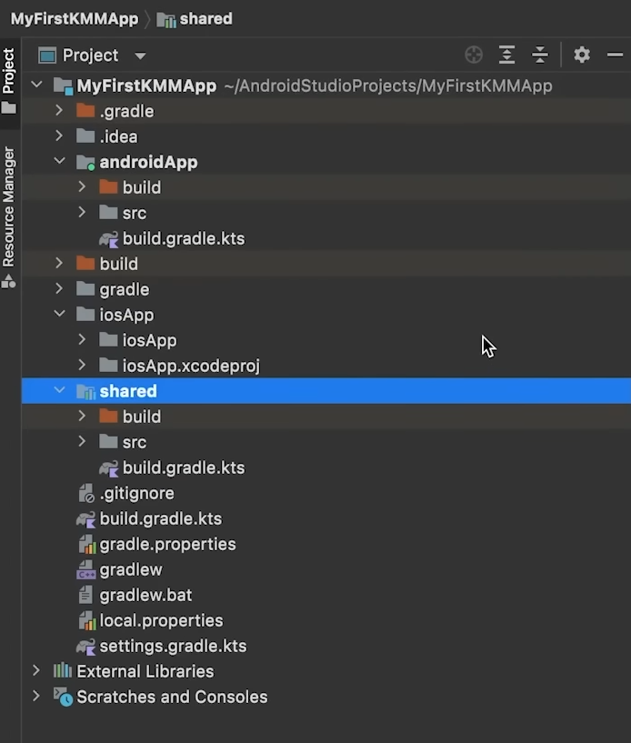
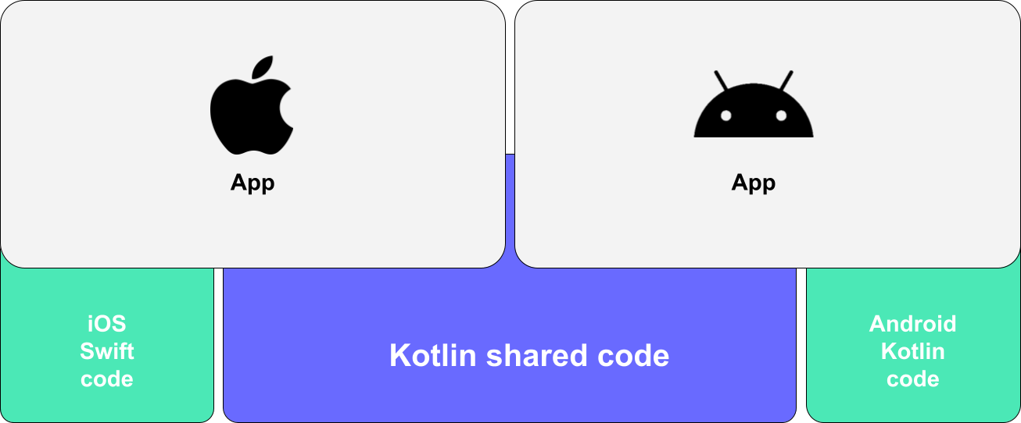

Slide 10
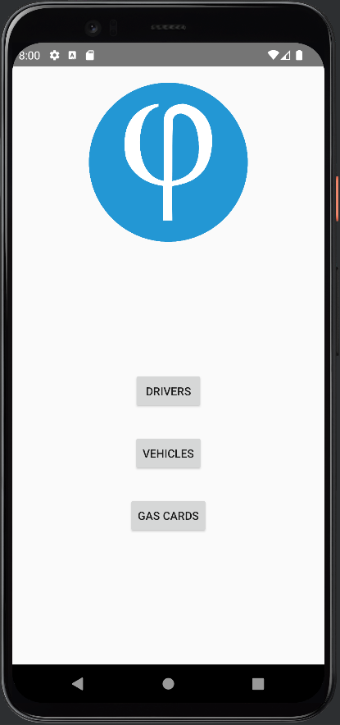
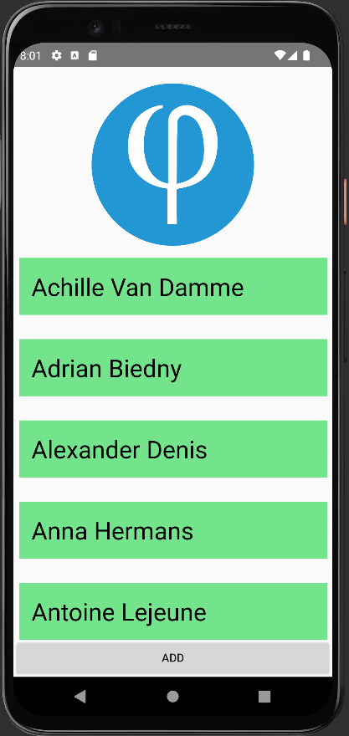
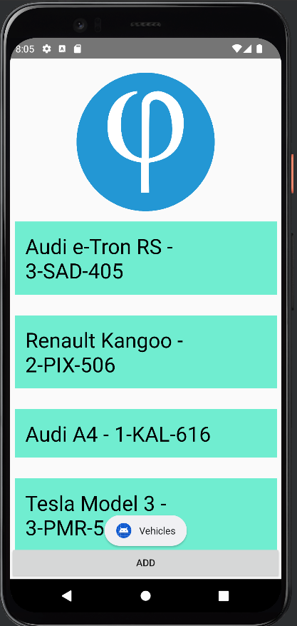
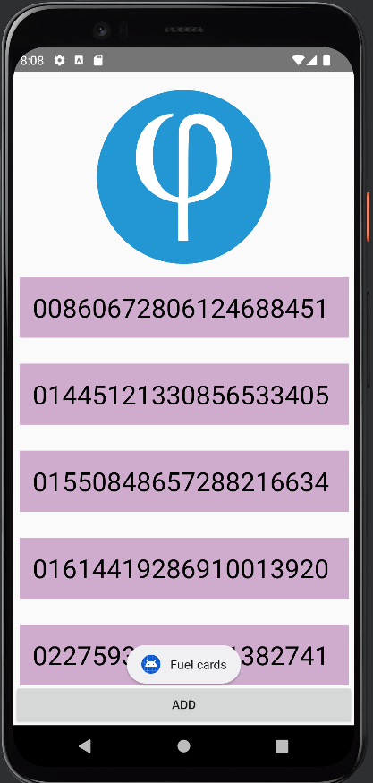

Slide 11
https://github.com/NotAffiche/StolosAPFMA

